Slide 1

Business Data Management
Capstone Project
InventoAnalysis : Kirana Store Analysis & Optimization
Name : Miryala Raam Sai Bharadwaj
Roll No : 21F2001492

Slide 2
Contents
1. Executive Summary - Introduction to Business
2. Data Collection & Cleaning - Data Collection and Cleaning Steps
3. Data Analysis - Analysis done in respect to the challenges
4. Findings - Important Insights about business
5. Recommendations - Solutions/Recommendations for business

Slide 3
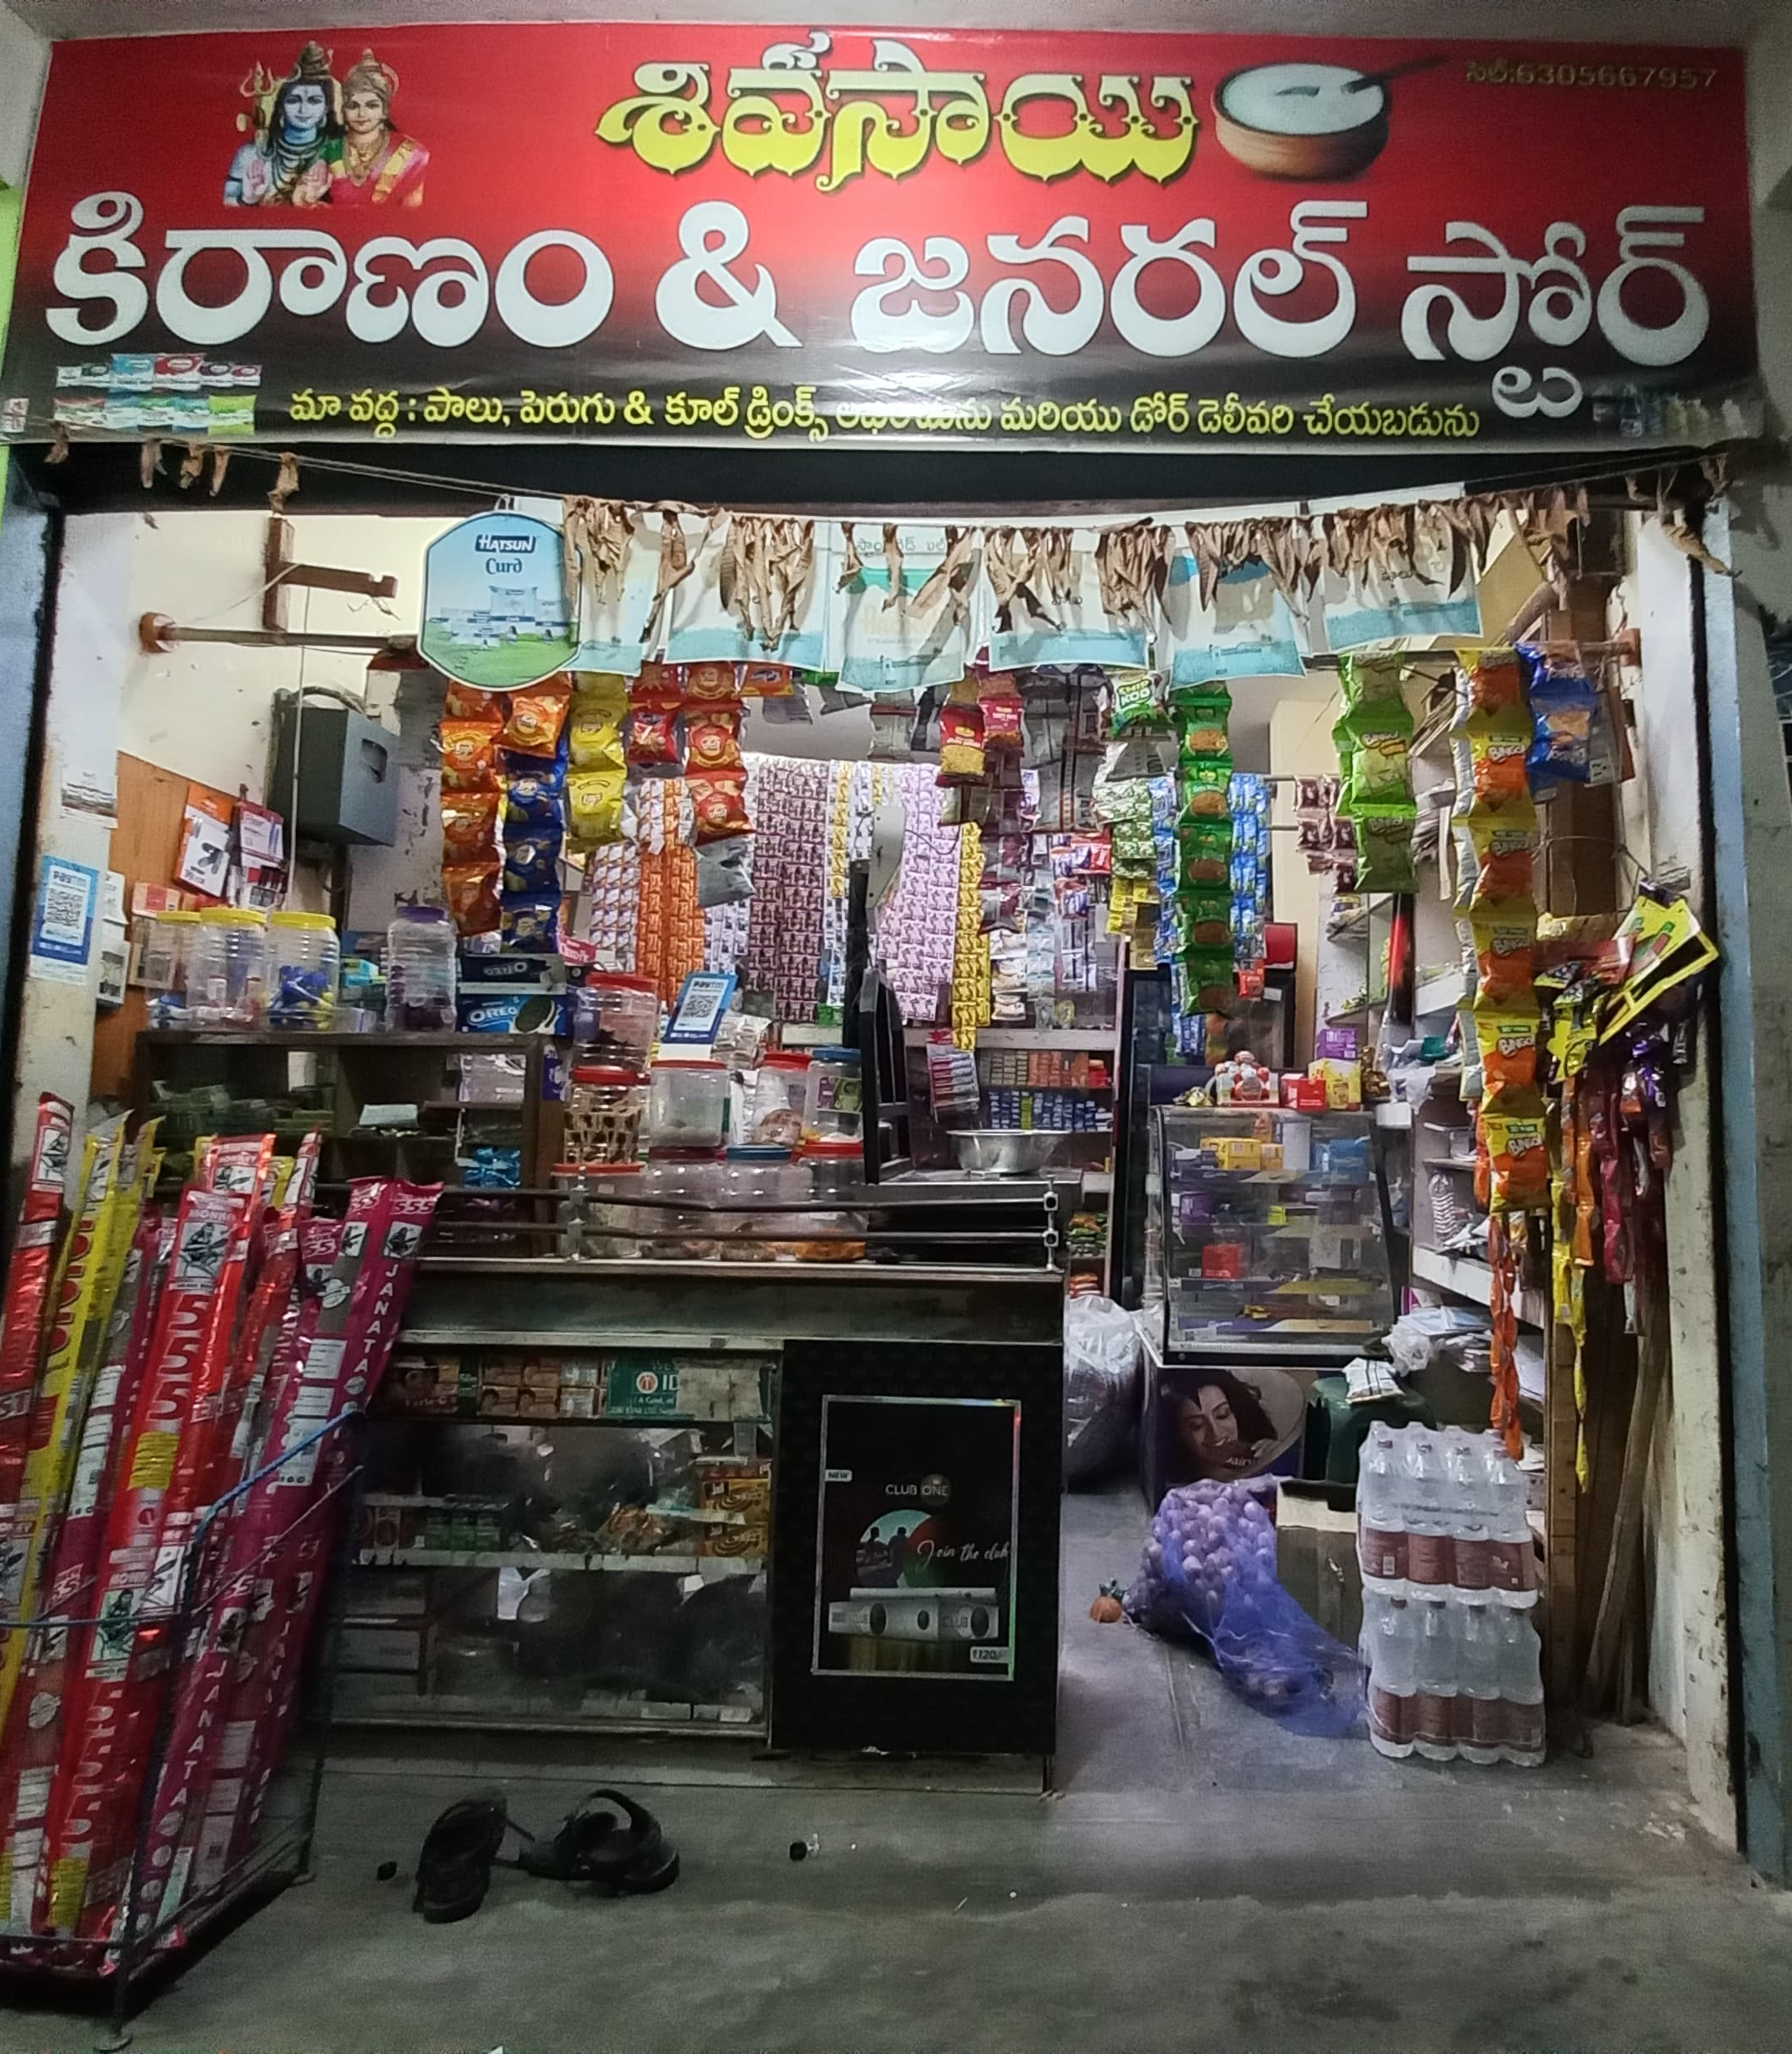
Executive Summary
The business which I collected data is a medium sized general purpose departmental store, started by Mr. Nagaraju Bikkumalla in early 2016.
The range of product sold by the store is generally cereals, grains, pulses, oils, milk and dairy products.
Unfortunately the store has been encountering challenges in terms of profit, sales and inventory management.

Slide 4
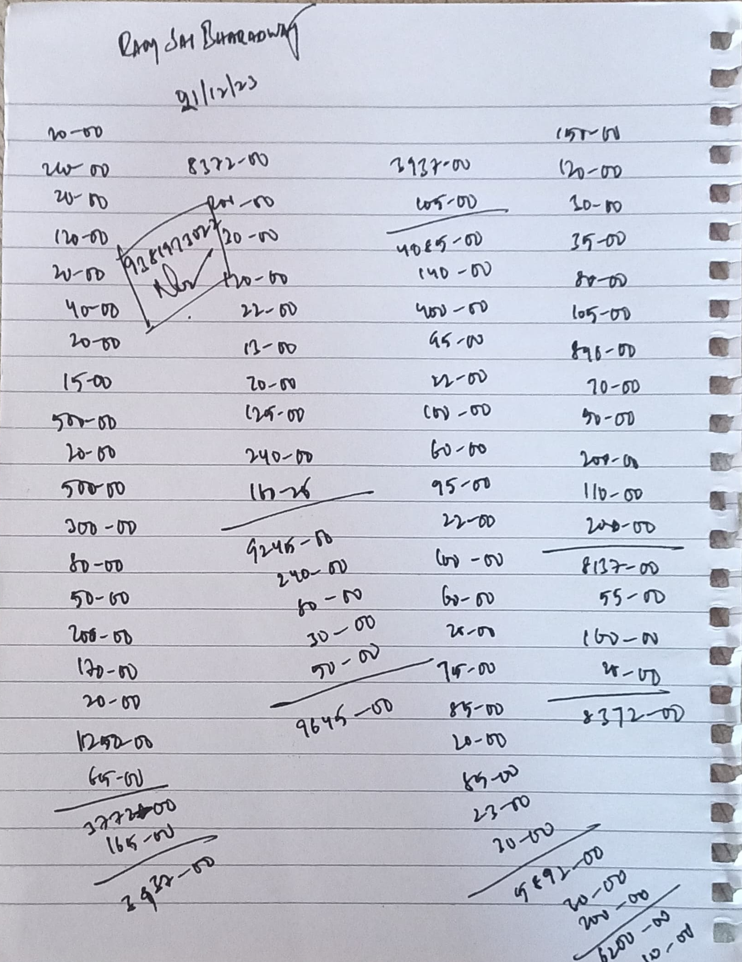
Data Collection And Cleaning
To Collect the data I went to store daily for 31 days and noted down the sales, purchase quantities, prices and inventory of 10 items.
Data collected for analysis was primary data and it was raw.
Hence to consolidated and clean the data, Microsoft Excel was used for cleaning and future analysis.

Slide 5
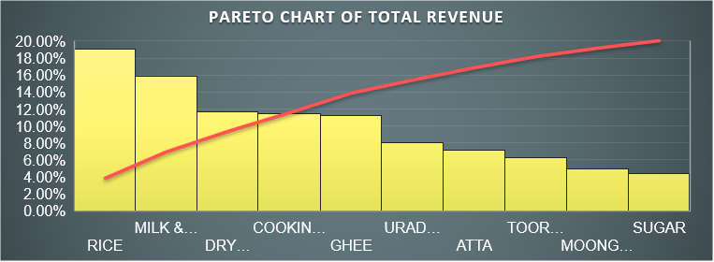
Data Analysis
Objective 1 : Sales
Highest revenue generating days : 10th – 16th
Average Daily Revenue : Rs.23,753
Deviation : Rs.16557.77
Minimum Revenue : Rs.8,093
Maximum Revenue : Rs.63,028
Range : Rs.54,935
Rice, Milk & Dairy, Dry Fruits, Cooking Oil, Ghee And Urad Dal are the main revenue generating SKU

Slide 6
Data Analysis
Objective 2 : Purchase
Tends to be a slight increase in purchase price for most of the SKU’s at middle of month except :
Cooking Oil Purchase price trends to show a dip.
Urad Dal Purchase price tends to show a significant increase.
Shop Owner made two wrong purchases, which were when prices was high, and seller have earned at least extra 10-15 Rs/Kg, if it would have been brought 2-3 days later or earlier in respective case

Slide 7
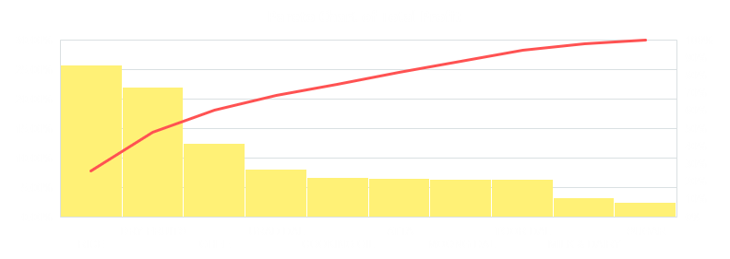
Data Analysis
Objective 3 : Profit/Loss
Rice, Dry Fruits, Ghee, Urad Dal, Cooking Oil and Atta are the 6 SKU contributing to the 80% of shop total profit
Dry Fruits and Ghee sales volume (1.1% and 2.1%) need to be improved for the shop to increase its net profit
Dry Fruits and Ghee are the items that holds maximum profit generating capacity

Slide 8
Data Analysis
Objective 4 : Inventory
There are no abnormalities in the average stock as per sales but there are high fluctuation/variance in stock present in the inventory for every SKU
There are no Abnormalities but as per owner claim there must be something wrong?

Slide 9
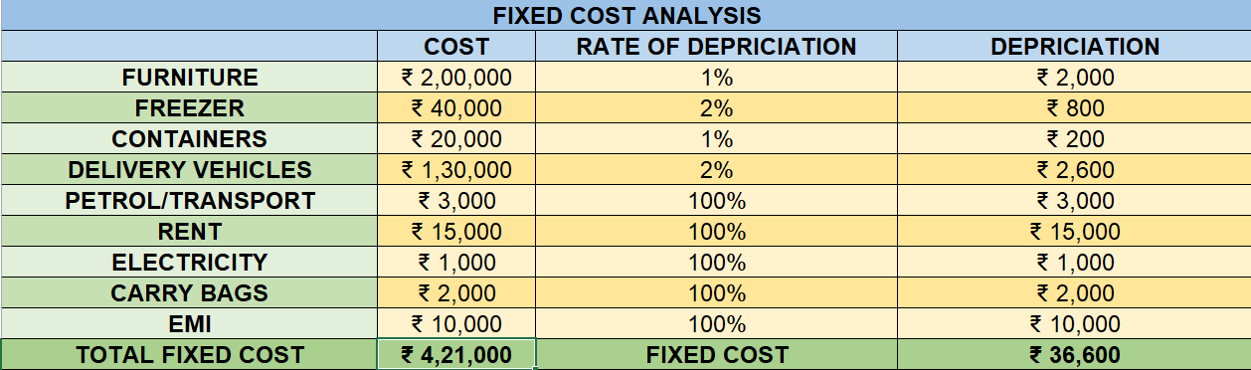
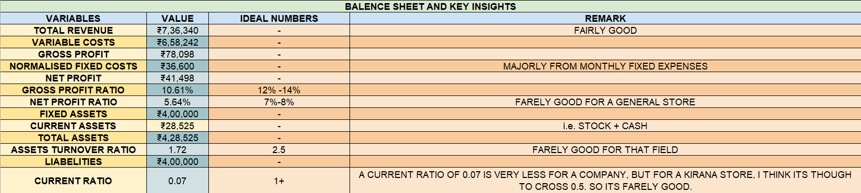
Findings ( PL & Insights)

Slide 10
Recommendations
Increase the sales of high profit items (such as :- Dry Fruits & Ghee).
Increasing sales of Milk.
Restock inventory earlier than usual or during high sales periods.
Increase Current Ratio.
Effective Pricing Strategies.
Enhance Store Display.

